Slide 1





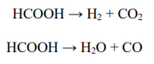
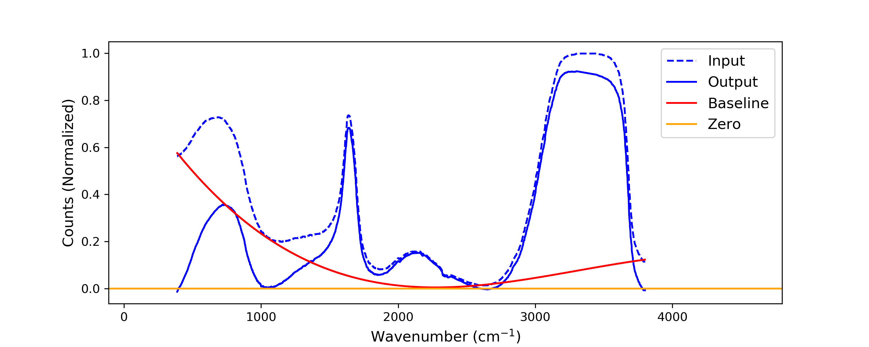
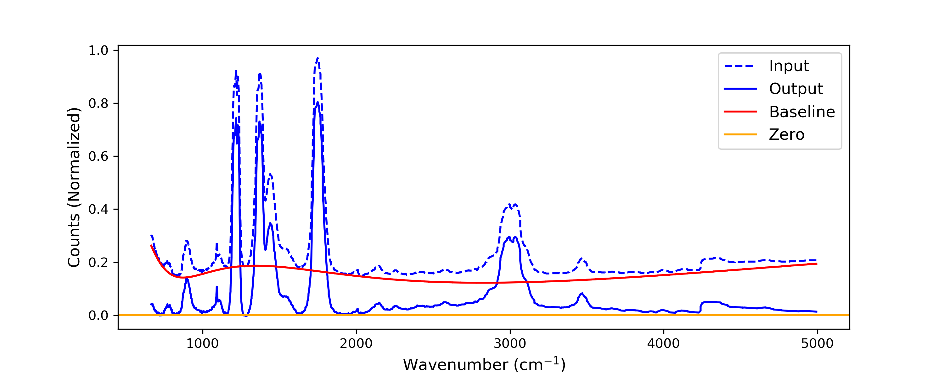
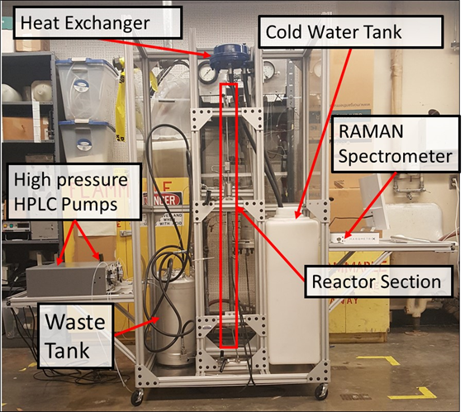
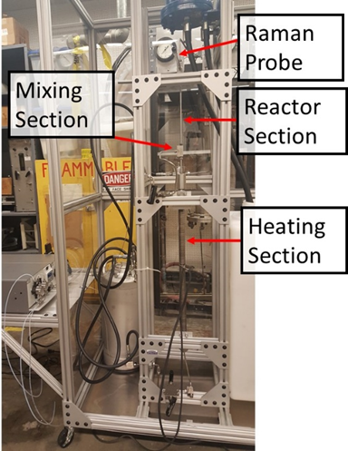
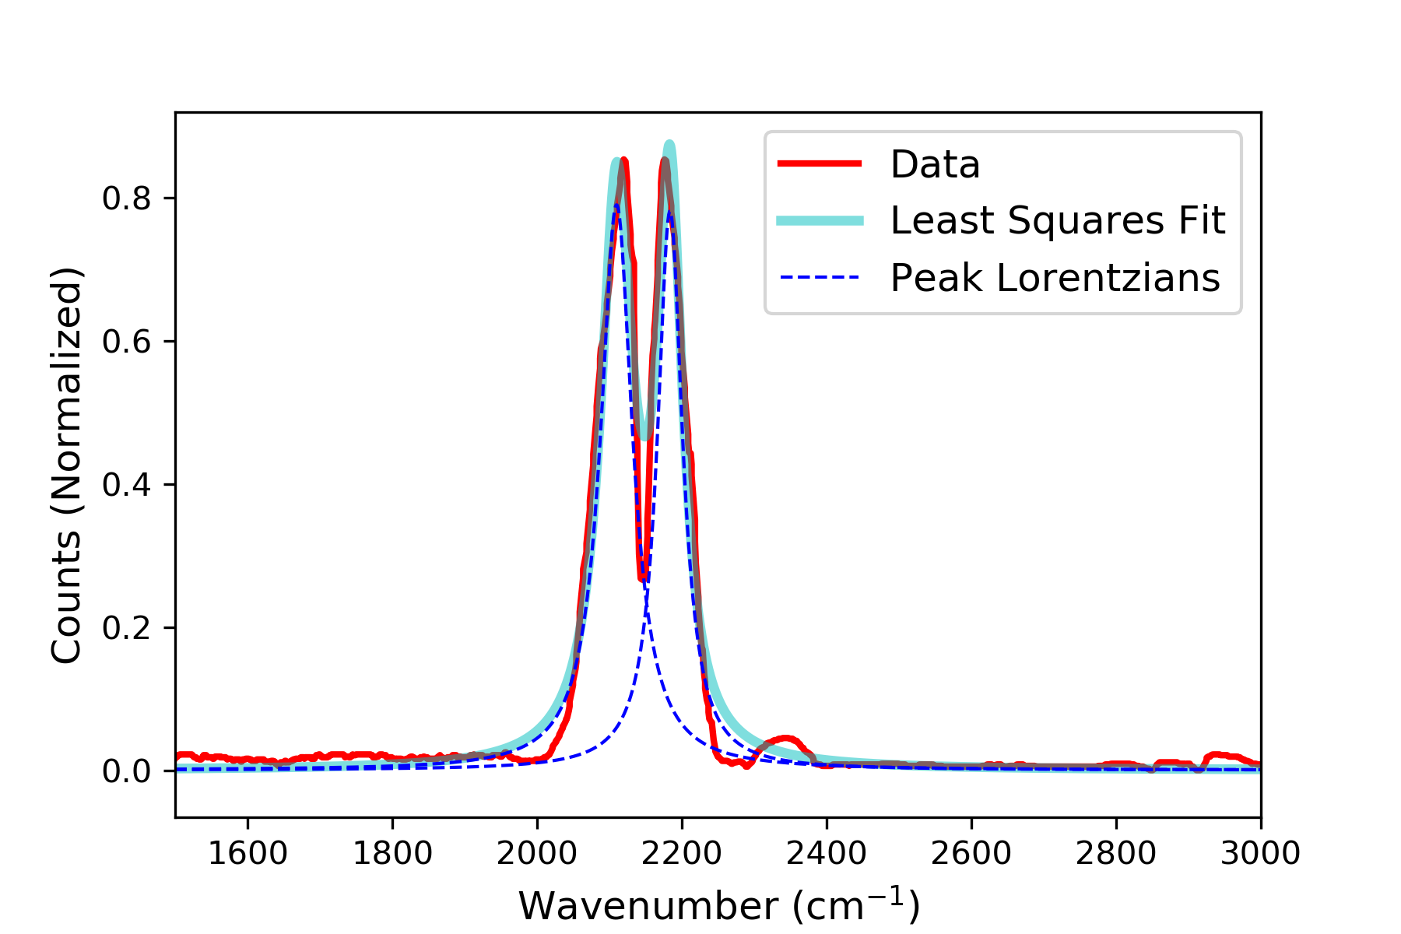
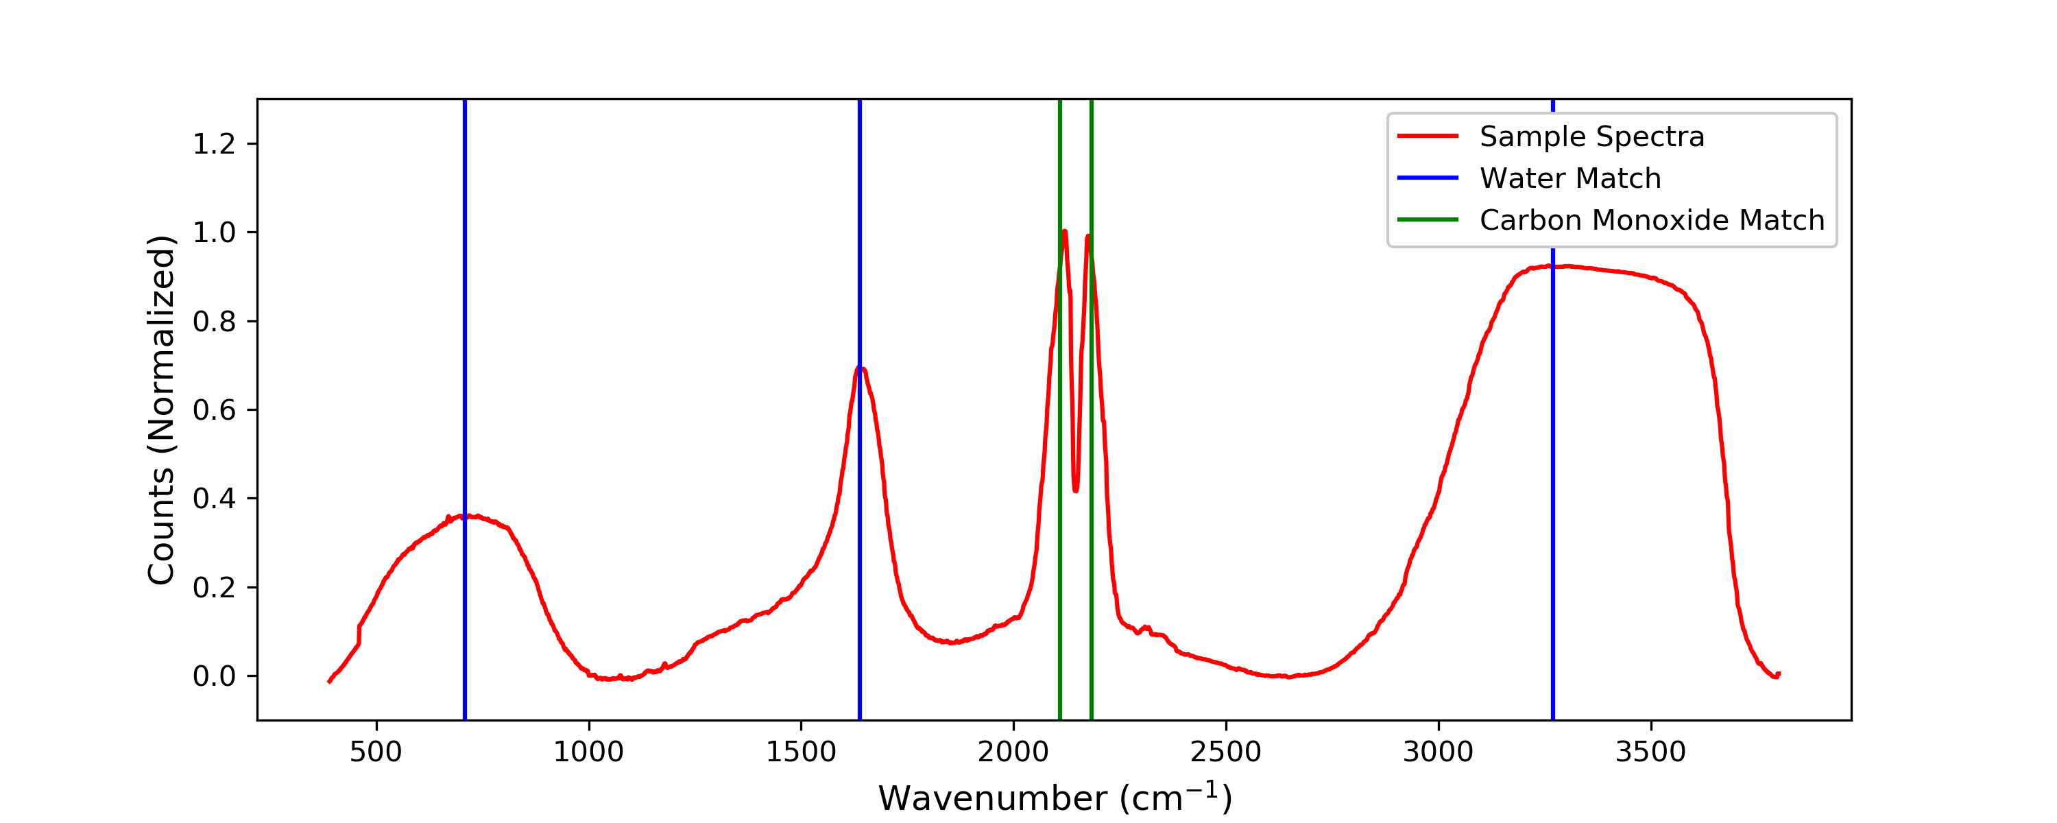
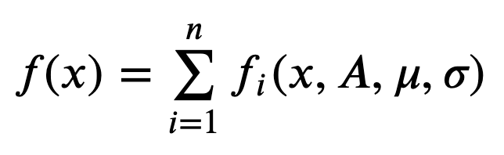
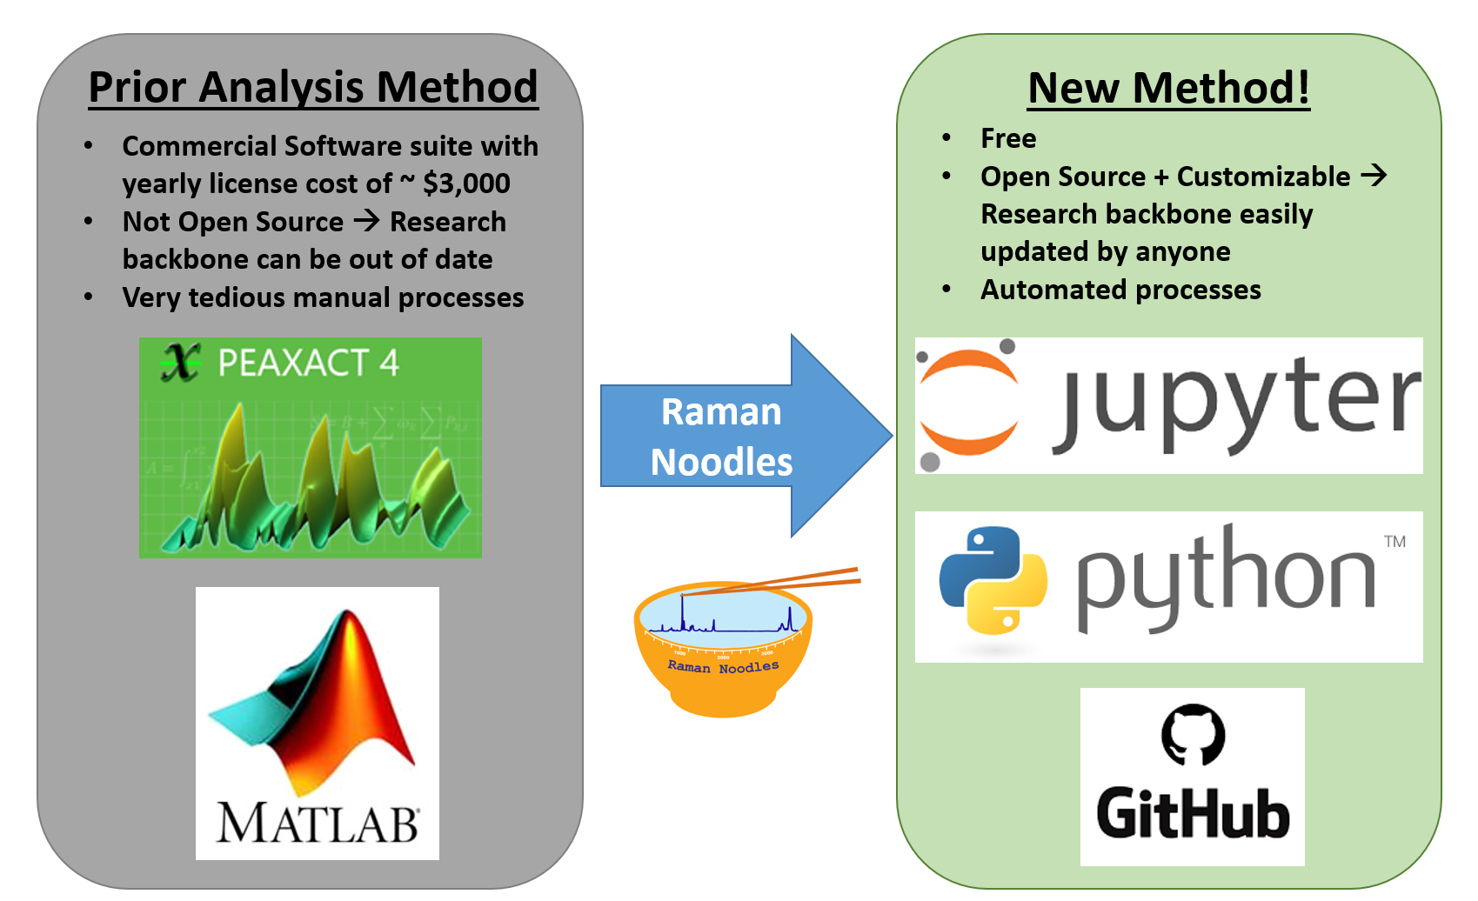
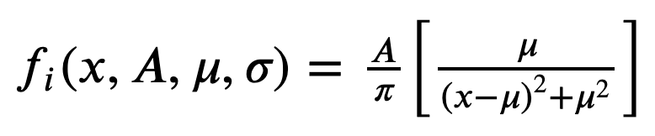
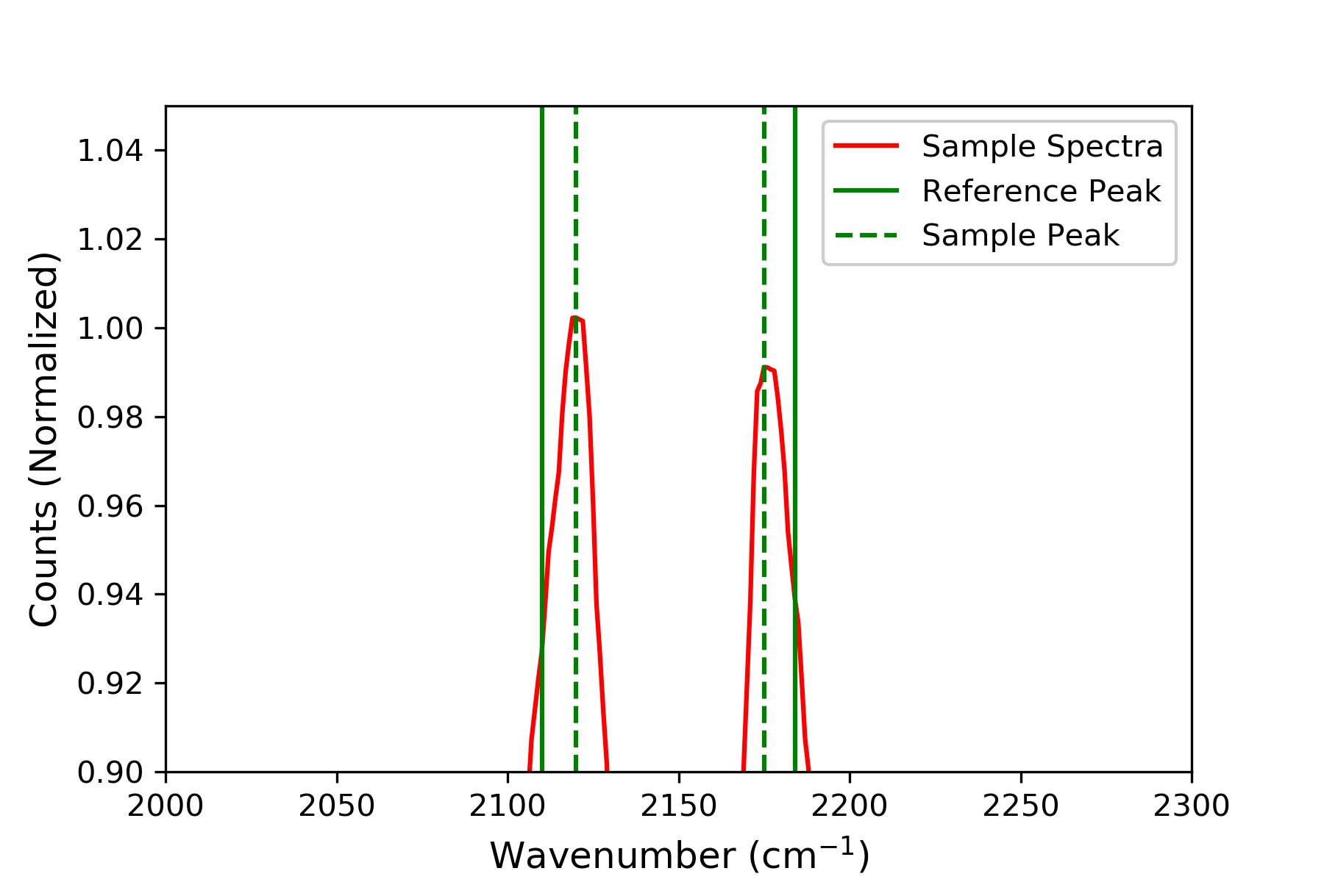
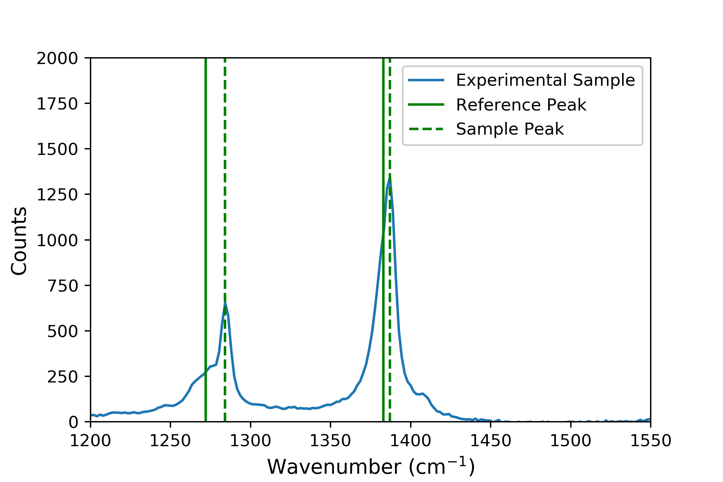
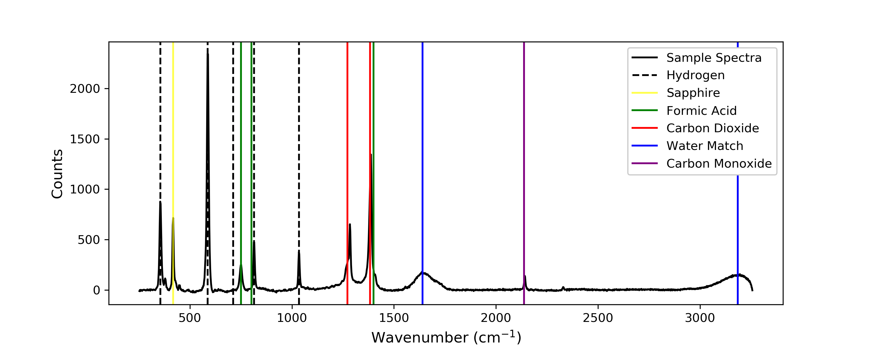
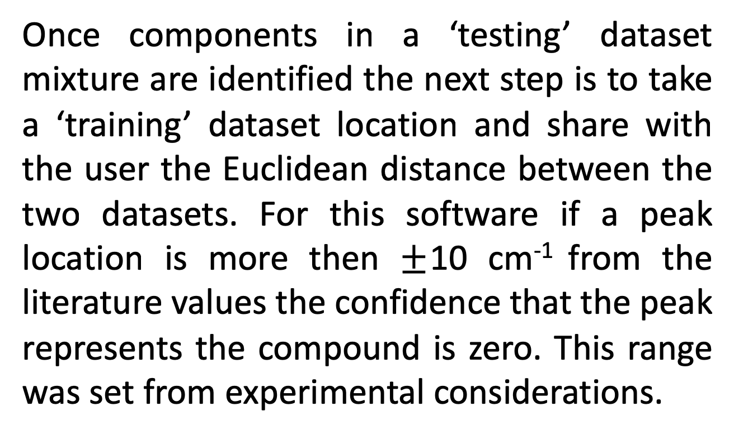
In-Situ Raman Spectroscopy Component Identification for Machine Learning Based Decomposition Analysis
Brandon Kern², Elizabeth Rasmussen^{1,3}, Jon Onorato^{2,3}, Parker Steichen²
¹ Department of Mechanical Engineering, ² Department of Material Science and Engineering, ³ Clean Energy Institute
University of Washington, Seattle, WA, USA
Introduction
Formic Acid gasified at 400°C
Pressure held constant at 25 MPa
Residence time of Xs
Constant fedstock concentration of 15 wt%
Continuing Work
Materials and Methods
Using data from a custom built supercritical gasification reactor on campus to analyze formic acid Raman spectra.
Decomposition of formic acid constitutes the combination of two pathways:
Baseline Subtraction of Raman Signal
Machine Learning for Material Decomposition
We implemented functionality to run a least squares regression that fits Lorentzian curves to the data. The function is given the peak locations determined using scipy.signal.find_peaks.
Expand software to be able to compute decomposition rates across varying parameters such as temperature, resonance time, possibly pressure.
From the defined decomposition rate the software can predict the decomposition rates using machine learning beyond the known data set limits
Used PeakUtils built in baseline function to perform polynomial fit baseline subtraction on NIST database spectra. Examples of this functionality are shown below.
Water Baseline Subtraction Output
Acetone Baseline Subtraction Output
Photographs of UW Gasification Reactor with In-Situ Raman Probe
Component Analysis in a Mixture Raman Signal
Carbon Monoxide Spectra Lorentzian Output
The LMFit package was utilized to identify 5 descriptors per peak in a mixture’s Raman signal including: location of the peak, peak height, and peak width. As a mixture has more peaks (components from decomposition) the amount of descriptors increases.
Least Squares Model Equation
Motivation
Lorentzian Equation for a Single Peak
Component Confidence based on Euclidean Distance
Once components in a ‘testing’ dataset mixture are identified the next step is to take a ‘training’ dataset location and share with the user the Euclidean distance between the two datasets. For this software if a peak location is more then $±$10 cm⁻¹ from the literature values the confidence that the peak represents the compound is zero. This range was set from experimental considerations.
Conclusions and Future Work
In conclusion our team successfully created a fast functioning open source code base that saves hours of research time in data cleaning and analysis of Raman Spectra. We have also set a strong base for the next step of our focus which is on calculating decomposition of substances using Lorentzian peak information that will be applied to machine learning optimum temperatures and pressures in a gasification reactor system.
Future work
This work sets up a free and user friendly platform for researchers to be able to analyze their own Raman Spectra.
Results Using Experimental Data
Goals
After creating a theoretical NIST ‘training’ datasets and proving the functionality of the code the final step was to test it on experimental data sets taken in the lab.
Acknowledgements
Data Mining and Baseline Subtraction
Importing open source data sets, create a library of spectra, uniformly format data for analysis
Data Visualization
Outputting plots of baseline subtraction and peak identification
Machine Learning
Prepare least squares regression model for calculating kinetic rate decomposition at different resonance times and temperatures
Dave Beck, Chad Curtis, and Kelly Thornton
Data sets were taken from publicly available from the NIST WebBook Database and Mendeley Data, “Raman Spectra of Formic Acid Gasification Products in Subcritical and Supercritical Water”
Only open source packages were used in this work, documentation of all packages used can be found at our GitHub at:
https://github.com/raman-noodles/Raman-noodles

